Slide 1

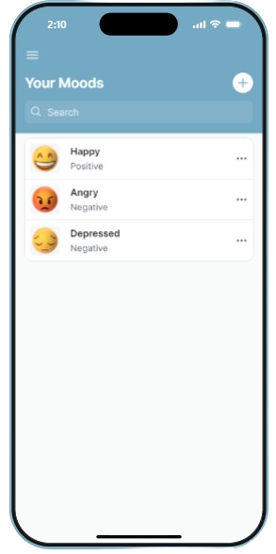

MOOD
REFLECT
SAI SANTOSH PAL
TRIBUVAN SANORIA
VIII-F
Under the guidance of
Ms. Manju Kasana
Mr. Subrat Mishra

Slide 2
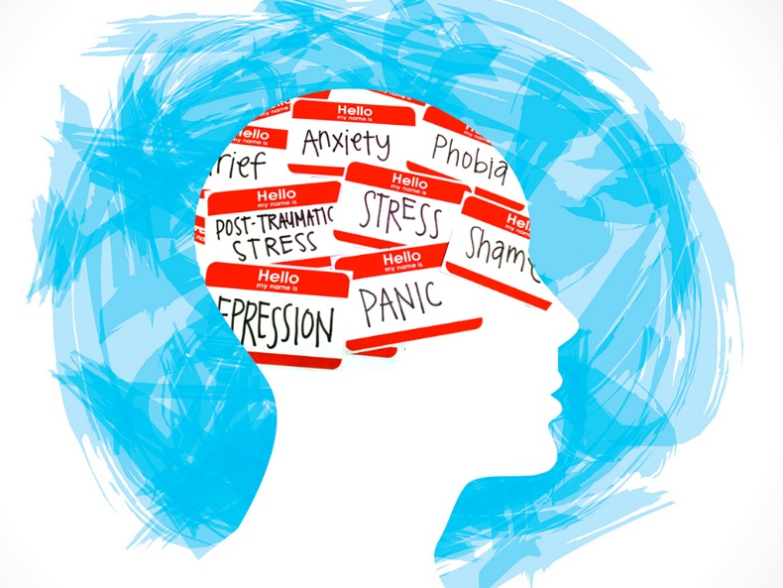
PROBLEM
Many students face challenges in managing their mental health and controlling their mood due to academic pressures, social expectations, and lifestyle factors.
The lack of a comprehensive tool to monitor and enhance emotional well-being results in difficulties recognizing patterns, accessing relevant resources, and building sustainable habits for improved mental health.

Slide 3

AIM
Mood Reflect aims to empower students in managing their mental health through personalized goal-setting, mood tracking, and curated content. Our goal is to provide a user-friendly and supportive platform, fostering a positive impact on students' overall well-being. In the medium term, we aim to become a go-to resource for students seeking holistic mental health support.

Slide 4
SOLUTION
Mood Reflect is a comprehensive app addressing students' mental health challenges through features like goal setting, mood tracking, and a rich repository of articles and yoga poses. It fosters a structured approach to mental well-being, offering insights into emotional patterns and a diverse content library. Integrating practical yoga poses for stress relief, personalized recommendations, and a user-friendly interface, Mood Reflect aims to make a positive impact on students' mental well-being.

Slide 5
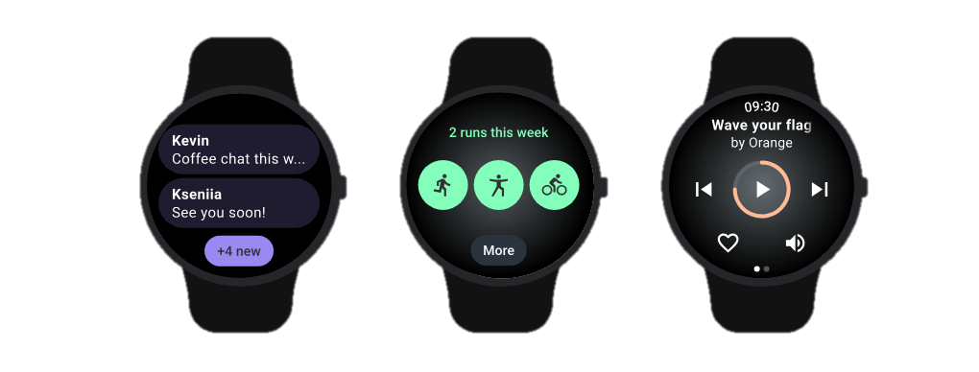

FUTURE SCOPE
The future scope for Mood Reflect holds promising opportunities for further enhancement and impact. Here are potential avenues for development:
Expanded Content Repository: Broaden the scope of the app by continually adding diverse and relevant content. This could include expanding the library of articles, incorporating audio content, and collaborating with experts for more specialized resources.
Integration with Wearable Technology: Explore the integration of Mood Reflect with wearable devices to capture real-time biometric data. This could provide users with a more nuanced understanding of the relationship between their physical well-being and emotional states.
AI-driven Personalization: Enhance the app's personalization capabilities by leveraging artificial intelligence. Implement algorithms that analyze user behavior and mood data to offer increasingly tailored recommendations and insights over time.

Slide 6
CONCLUSION
In conclusion, Mood Reflect stands at the forefront of addressing the critical mental health challenges faced by students. With a robust combination of features including goal setting, mood tracking, curated content, and yoga poses, the app offers a holistic approach to well-being. As we look to the future, there is immense potential for growth and impact. The incorporation of artificial intelligence, expansion of content offerings, and integration with wearable technology can further elevate the user experience. The emphasis on community support, gamification, and interactive tools demonstrates our commitment to creating a dynamic and engaging platform.

Slide 7
THANK YOU
SAI SANTOSH PAL
TRIBUVAN SANORIA
VIII-F
Under the guidance of
Ms. Manju Kasana
Mr. Subrat Mishra

